Slide 1

TERM PAPER: WEB SCRAPING USING PYTHON
Submitted By :
V.GNANESWAR (U19CB096)
V.V.HARIPRASAD (U19CB101)
Y.CHAITANYA SAI (U19CB124)
CSE-T

Slide 2
SCOPE OF PROJECT
Nowadays tons and tons of data generating every day through websites, applications and browsers. But processing and cleansing of these data is not so easy as generating data. So handling these data is difficult. This article will let you know the scraping data in websites, scopes, benefits and also drawbacks. Everything in this world has two sides good and bad. The betterment here is most of each sides matters.

Slide 3
ABSTRACT
In this project we use scrapy to scrape web sites and store the information in excel sheets. The website flipkart to be scraped is operated upon which we create using AI which function as bots.
A web crawler is a piece of code that travels the Internet and collects data from various web pages, also known as web scraping. Web scraping replaces the need for manual data entry and more easily reveals trends among data collected.
Main objective of web scraping is to extract information from one or many websites. Web crawlers then process the information into simple structures such as spreadsheets, database.

Slide 4
INTRODUCTION
Scrapy is a fast, open-source web crawling framework written in Python, used to extract the data from the web page with the help of selectors based on XPath.
Scrapy was first released on June 26, 2008 licensed under BSD, with a milestone 1.0 releasing in June 2015.
Unlike the long and mind-numbing process of manually getting data, Web scraping uses intelligence automation methods to get thousands or even millions of data sets in a smaller amount of time.

Slide 5
LITERATURE SURVEY
Renita Crystal Pereira and Vanitha T, “Web Scraping of Social Networks,” International Journal of Innovative Research in Computer and Communication Engineering, pp. 237-240, Vol. 3, 2015.
Kaushal Parikh, Dilip Singh, Dinesh Yadav and Mansingh Rathod, “Detection of web scraping using machine learning,” Open access international journal of Science and Engineering, pp.114-118, Vol. 3, 2018.
Sameer Padghan, Satish Chigle and Rahul Handoo, “Web Scraping-Data Extraction Using Java Application and Visual Basics Macros,” Journal of Advances and Scholarly Researches in Allied Education, pp. 691-695, Vol.15, 2018.

Slide 6
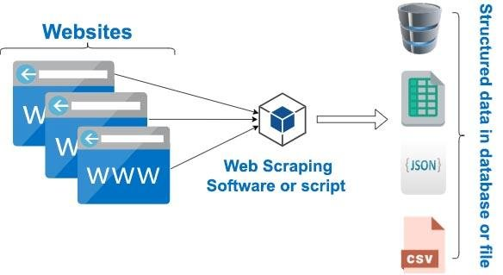
ARCHITECTURE DIAGRAM

Slide 7
Existing system
The proposed system for this project is a web scraper that is able to access and extract data from websites using a web application as an interface for user interaction.
The extracted data is then stored in a database, as the web application allows the user to search through and query the saved findings.

Slide 8
Proposed system
This project will assist you in extracting data and save it as a csv file.
The lines of code in this project are short, making it simple to understand, and by tweaking the little details, we can create a spreadsheet with any data we desire.

Slide 9
Modules
Pick a website and describe your objective
Browse through different sites and pick on to scrape.
Identify the information you'd like to scrape from the site. Decide the format of the output CSV file.
Summarize your project idea and outline your strategy in a Pycharm notebook. Use the "New" button above.

Slide 10
Use the requests library to download web pages
Inspect the website's HTML source and identify the right URLs to download.
Download and save web pages locally using the requests library.
Create a function to automate downloading for different topics/search queries.

Slide 11
Use Beautiful Soup to parse and extract information
Parse and explore the structure of downloaded web pages using Beautiful soup.
Use the right properties and methods to extract the required information.
Create functions to extract from the page into lists and dictionaries.
(Optional) Use a REST API to acquire additional information if required.

Slide 12
Create CSV file(s) with the extracted information
Create functions for the end-to-end process of downloading, parsing, and saving CSVs.
Execute the function with different inputs to create a dataset of CSV files.
Verify the information in the CSV files by reading them back

Slide 13
Beautiful Soup is a Python library for pulling data out of HTML and XML files. It is mainly designed for projects like screen-scraping. This library provides simple methods and Pythonic idioms for navigating, searching, and modifying a parse tree.
import urllib3
from bs4 import BeautifulSoup
http = urllib3.PoolManager()
r = http.request('GET','https://authoraditiagarwal.com') soup = BeautifulSoup(r.data, 'lxml’)
print (soup.title)
print (soup.title.text)
This is the output you will observe when you run this code
<title>Learn and Grow with Aditi Agarwal</title>
Learn and Grow with Aditi Agarwal

Slide 14
Urllib3
It is another Python library that can be used for retrieving data from URLs similar to the requests library.
Using the pip command, we can install urllib3 either in our virtual environment or in global installation.
(base) D:\ProgramData>pip install urllib3
Collecting urllib3
Using cached https://files.pythonhosted.org/packages/bd/c9/6fdd990019071a4a32a5e7cb78a1d92c5
3851ef4f56f62a3486e6a7d8ffb/urllib3-1.23-py2.py3-none-any.whl Installing collected packages: urllib3
Successfully installed urllib3-1.23

Slide 15
Python Requests
It is a simple python web scraping library. It is an efficient HTTP library used for accessing web pages. With the help of Requests, we can get the raw HTML of web pages which can then be parsed for retrieving the data. Before using requests, let us understand its installation.
Installing Requests
We can install it in either on our virtual environment or on the global installation. With the help of pip command, we can easily install it as follows −

Slide 16
(base) D:\ProgramData> pip install requests
Collecting requests
Using cached
https://files.pythonhosted.org/packages/65/47/7e02164a2a3db50ed6d8a6ab1d6d60b69
c4c3fdf57a284257925dfc12bda/requests-2.19.1-py2.py3-none-any.whl
Requirement already satisfied: idna<2.8,>=2.5 in d:\programdata\lib\sitepackages
(from requests) (2.6)
Requirement already satisfied: urllib3<1.24,>=1.21.1 in
d:\programdata\lib\site-packages (from requests) (1.22)
Requirement already satisfied: certifi>=2017.4.17 in d:\programdata\lib\sitepackages
(from requests) (2018.1.18)
Requirement already satisfied: chardet<3.1.0,>=3.0.2 in
d:\programdata\lib\site-packages (from requests) (3.0.4)
Installing collected packages: requests
Successfully installed requests-2.19.1

Slide 17
Scrapy
Scrapy was first released on June 26, 2008 licensed under BSD, with a milestone 1.0 releasing in June 2015. It provides us all the tools we need to extract, process and structure the data from websites.
Installing Scrapy
Using the pip command, we can install urllib3 either in our virtual environment or in global installation.
pip install scrapy

Slide 18
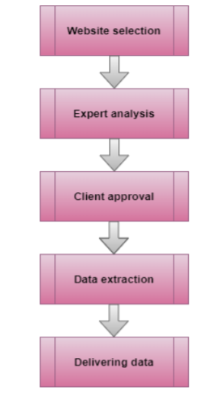
Phases of Web scraping

Slide 19
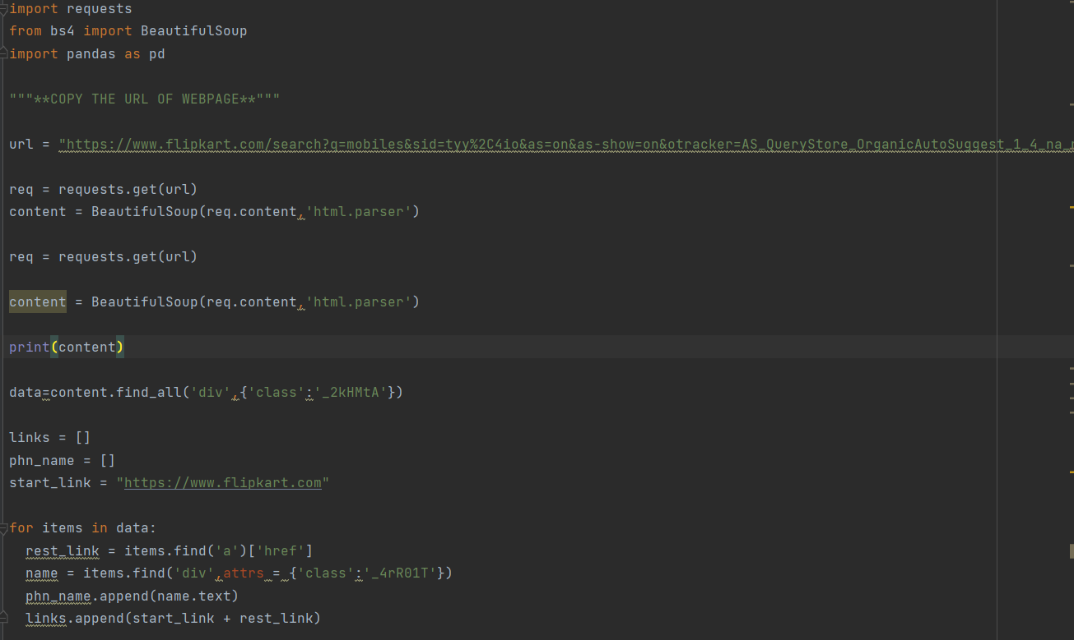
CODE IMPLEMENTATION

Slide 20
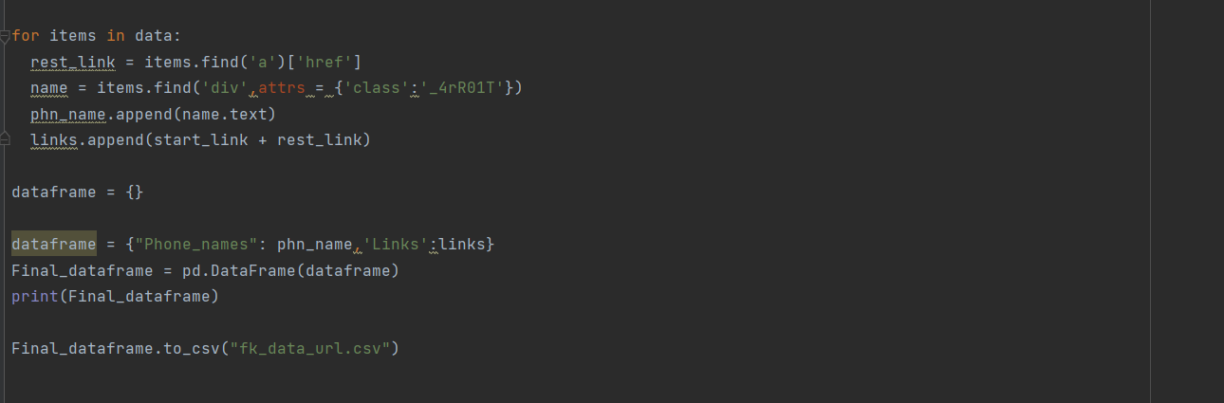
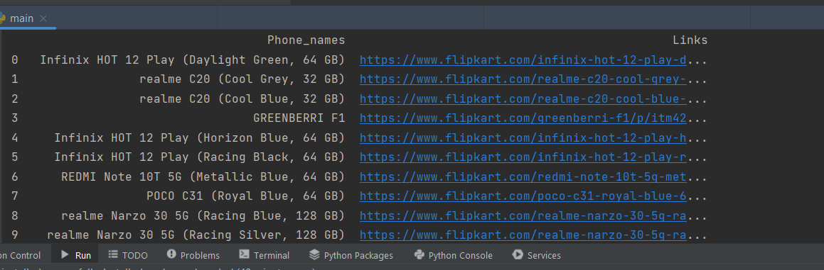
Figure : items.py
Figure : running the script on terminal

Slide 21
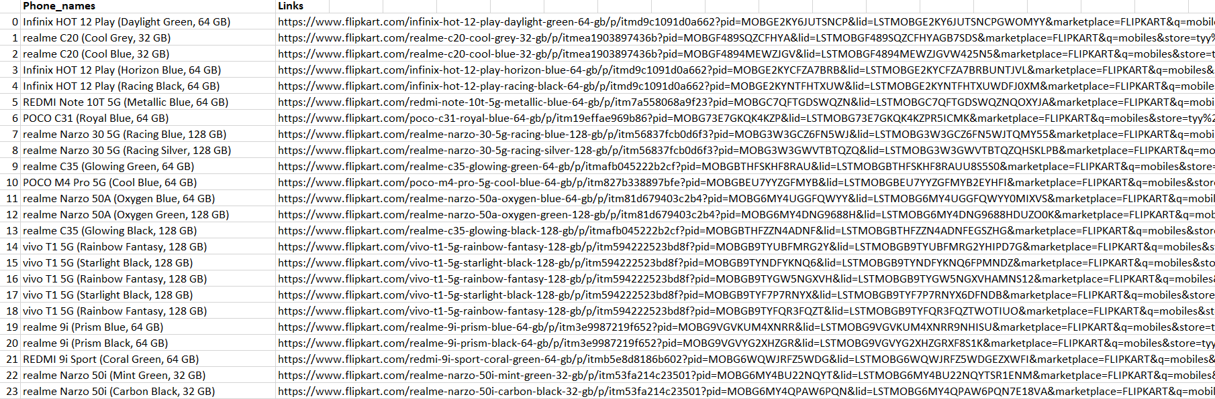
Figure : result in dict_file.csv

Slide 22
CODE EXPLANATION
The code starts by importing the libraries needed for the program.
The code then creates a variable called url which is set to
https://www.flipkart.com/search?q=mobiles&sid=tyy%2C4io&as=on&as-show=on&otracker=AS_QueryStore_OrganicAutoSuggest_1_4_na_na_na&otracker1=AS_QueryStore_OrganicAutoSuggest_1_4_na-na-na and it also sets the suggestion Id to mobiles%7CMobiles .
The next line of code requests data from this webpage using requests library, which returns a BeautifulSoup object with all of the HTML content on that page as its contents.
This object is then parsed into an array of strings using html.parser function in bs4 library, and these are stored in content variable.
Next, we print out what's inside this object so that we can see what's going on: print(content)
The code is a Python script that would be used to import the data from a webpage into a pandas Data Frame.
The code above first imports the requests library and then uses it to get the content of an URL which is Flipkart's search page.
The content of this page is then parsed using BeautifulSoup in order to extract all the links on this page.

Slide 23
CONCLUSION
Extracting data through scraping technology is a new evolving activity in the technology harvesting arena. Though many companies are still using manual process of extracting data but Web Scraping solutions will transform the traditional method of extracting data.
The day is not that far with exponential growth throughout this field when it can become a phenomenon and most companies will understand the value of scraping innovation and how it enables them remain ahead in the race dramatically.

Slide 24
Contd..
This paper presents the survey of Web scraping technology incorporating what it is, how it works, the popular tools and technologies Banking Sector Online media Consultancy management Insurance Network and security Marketing Finance Internet Computer software IT Sector 0 10 20 30 40 50 60 Small websites Average websites Large websites .

Slide 25
REFERENCES
[1] Renita Crystal Pereira and Vanitha T, “Web Scraping of Social Networks,” International Journal of Innovative Research in Computer and Communication Engineering, pp. 237-240, Vol. 3, 2015.
[2] Kaushal Parikh, Dilip Singh, Dinesh Yadav and Mansingh Rathod, “Detection of web scraping using machine learning,” Open access international journal of Science and Engineering, pp.114-118, Vol. 3, 2018.
[3] Sameer Padghan, Satish Chigle and Rahul Handoo, “Web Scraping-Data Extraction Using Java Application and Visual Basics Macros,” Journal of Advances and Scholarly Researches in Allied Education, pp. 691-695, Vol.15, 2018.
[4] www.scrapy.org

